Slide 1
Module 1.4:
Unsupervised Learning
Clustering; Dimensionality Reduction
ML for Cybersecurity

Slide 2
Motivating example in cybersecurity
Notes:
As usual, suggest contrasting with what came before, and including 1 or more examples to illustrate

Slide 3
Unsupervised Learning
Learning without labels
Typically useful for exploratory data analysis (find patterns, visualization)
Most common methods
Clustering (unsupervised classification)
Dimensionality reduction (unsupervised regression)

Slide 4
Clustering

Slide 5
What is Clustering?
Given data points, group into clusters such that
Similar points are in the same cluster
Dissimilar points are in different clusters
Points are typically represented either
in (high-dimensional) Euclidean space
with distances specified by a metric or kernel
Related: Anomaly / outlier detection
Identification of points that “don’t fit well in any of the clusters”

Slide 6
Standard Approaches to Clustering
Hierarchical clustering
Build a tree (bottom-up or top-down), representing distances among data points
Example: single-, average- linkage clustering
Partitional approaches
Define and optimize a notion of “cost” defined over partitions
Example: Spectral clustering, graph-cut based approaches
Model-based approaches
Maintain cluster “models” and infer cluster membership (e.g., assign each point to closest center)
Example: k-means, Gaussian mixture models, …

Slide 7

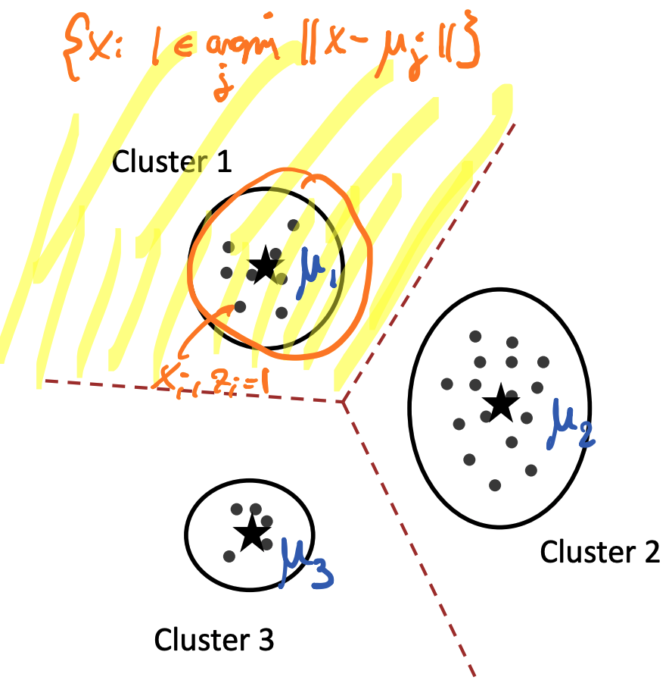
K-means Clustering
Represent each cluster by single point (center)
Assign points to closest center
Induces Voronoi partition
Credit @NOELIAGOROD

Slide 8
K-means Algorithm
Initialize cluster centers
While not converged
Assign each point to closest center
Update center as mean of assigned data points

Slide 9
Properties and challenges with K-means
Generally only converges to local optimum
Performance strongly dependent on initialization!
Number of iterations required can be exponential
In practice however often converges very quickly
Cannot well model clusters of arbitrary shape
Determining the number of clusters k is difficult
Notes:
Like this slide a lot. Might be an opportunity to mention use cases that would work or not work well with k-means.
Might also compare K-means to the different clustering approaches mentioned back in slide 5 and where learners might want to try them

Slide 10
Dimensionality Reduction

Slide 11
Basic Challenge
Given data set
obtain “embedding” (low-dimensional representation)
Motivation
Visualization (k=1,2,3)
Regularization (model selection)
Unsupervised feature discovery (i.e., determine features from data!)

Slide 12
Example
Given data set
obtain “embedding” (low-dimensional representation)
Motivation
Visualization (k=1,2,3)
Regularization (model selection)
Unsupervised feature discovery (i.e., determine features from data!)

Slide 13
Typical Approaches
Linear dimension reduction
PCA, SVD, LDA
Nonlinear dimension reduction
(parametric or non-parametric)
Credit @NOELIAGOROD

Slide 14
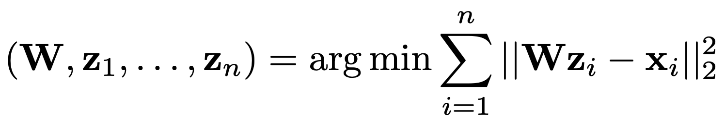

Principal Component Analysis (PCA)
Suppose we wish to project data from d to k dimension:
This is called the Principal Component Analysis problem
Its solution can be obtained in closed form even for k>1

Slide 15
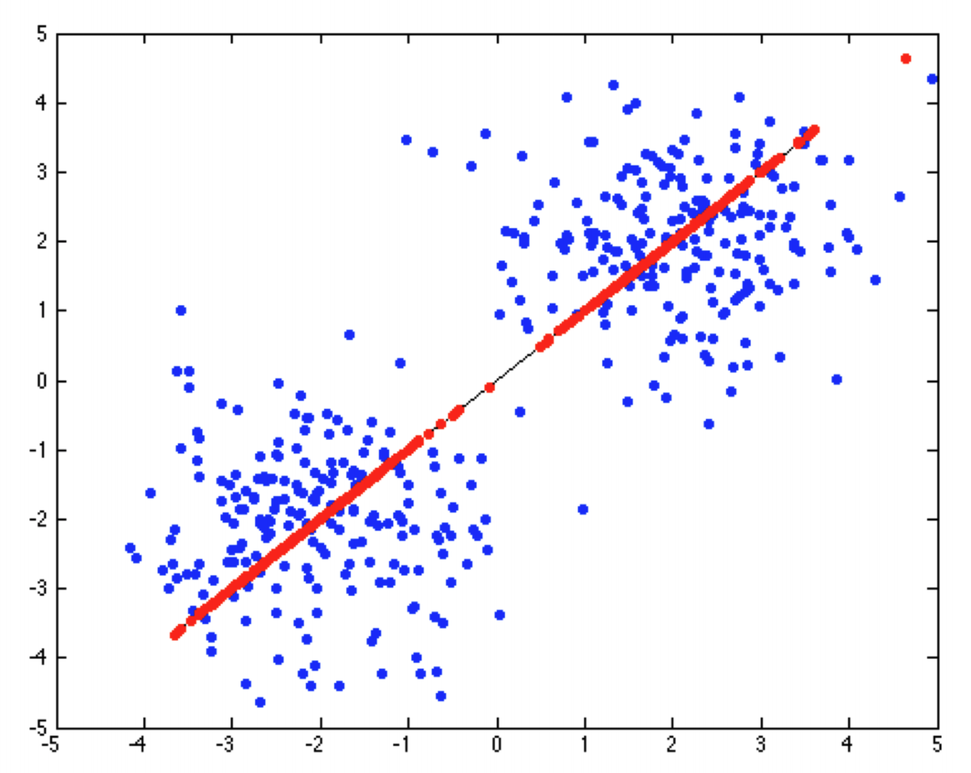
PCA is a Projection
The linear mapping obtained from PCA projects vectors into a k-dimensional subspace
This projection is chosen to minimize the reconstruction error (measured in Euclidean norm)

Slide 16
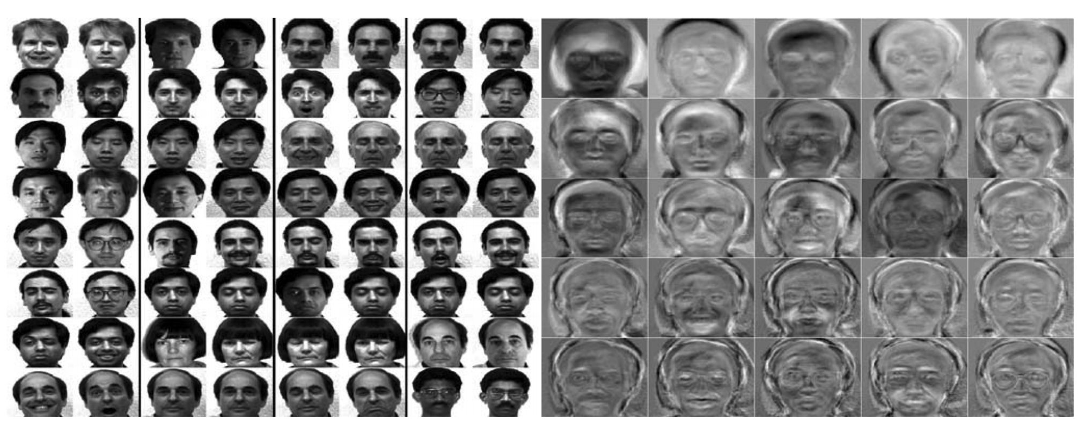
Example: Eigen Faces

Slide 17
Concluding remarks
Notes:
Matt/Laura:
This slide doesn’t exist but it could be a good opportunity to summarize the main takeaways from this section.

